Slide 1



GLOBAL POWER PLATFORM BOOTCAMP
Organized Globally, Held Locally

Slide 2
Updating QnA Maker using Power Automate
Aakash Bhardwaj

Slide 3



Aakash Bhardwaj
Microsoft 365 Developer at HCL Technologies
Around 6 years of experience in SharePoint
Active Contributor to SharePoint Patterns & Practices Community
@aakash_316
https://www.linkedin.com/in/aakash-bhardwaj-1a0348b8/

Slide 4
Session Agenda
QnA Maker
Knowledge Base
Power Automate Integration
Demo
References

Slide 5
QnA Maker

Slide 6
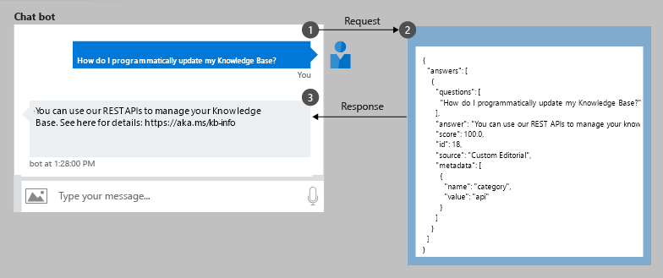
Overview
QnA Maker is an Azure service that can be used to find the best answer for any question from a custom knowledge base of QnA pairs
It supports features like NLP, active learning and multi-turn prompts
It can be used to easily create a no code chat bot

Slide 7
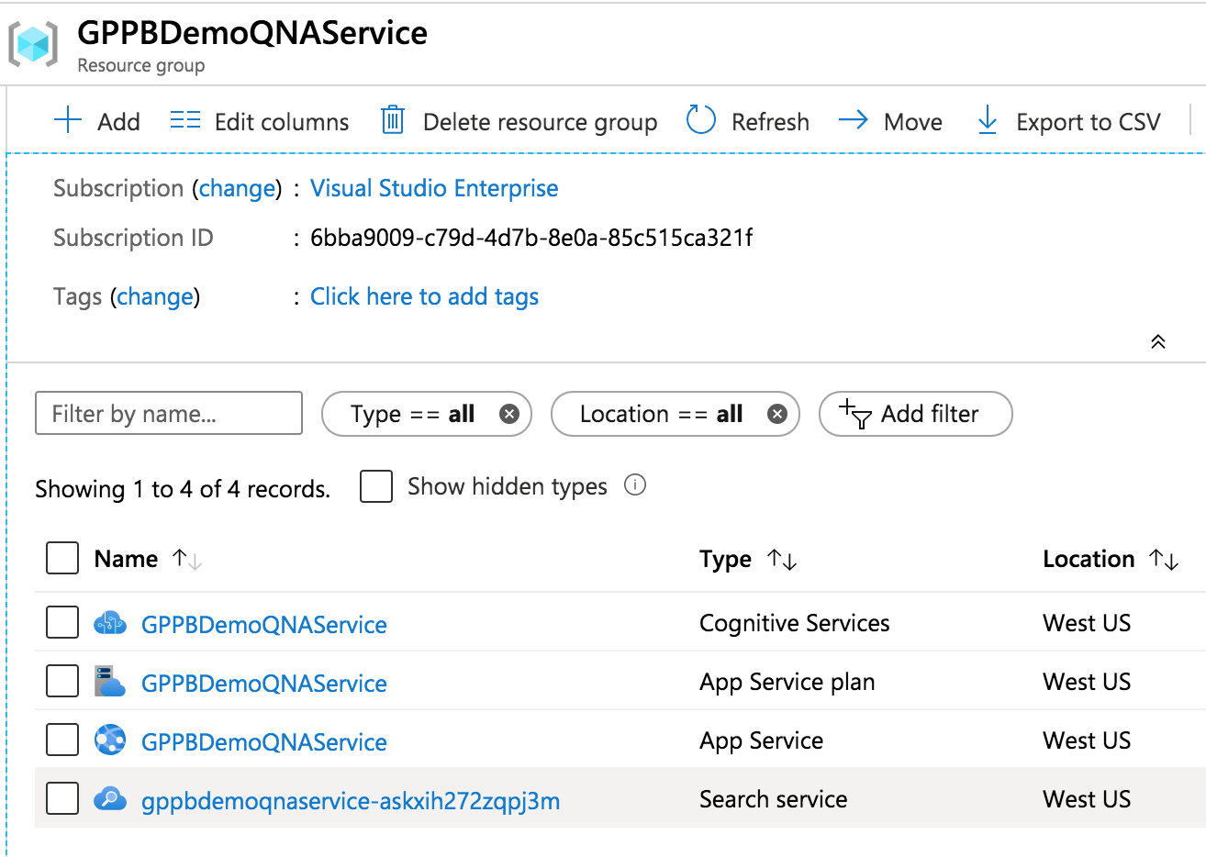
Azure Resources
The following resources are created when a new QnA Maker service is created:
QnA Maker Cognitive Services
App Service Plan
App Service
Application Insights (Optional)
Search Service
The resources are easily scalable and can be scaled as per changing demands

Slide 8
Knowledge Base

Slide 9
Updating Knowledge Base
Editorially add QnA using the portal
Automatic extraction from files and FAQ URLs
Update and manage programmatically using REST API
Every HTTP operation to the KB requires the KB Id and Ocp-Apim-Subscription-Key values
API Testing console at https://westus.dev.cognitive.microsoft.com/docs/services/5a93fcf85b4ccd136866eb37/operations/5ac266295b4ccd1554da7600

Slide 10
Power Automate Integration

Slide 11
Sync with SharePoint List
SharePoint List
Power Automate Flow
QnA Maker Knowledge Base
SharePoint list item created or modified triggered flow can be executed
HTTP Action can be used to update the Knowledge Base
This can help in keeping the SharePoint list in sync with QnA Maker

Slide 12
Pros
Cons
Add QnA pairs from within SharePoint
Add approvals or notification updates using Power Automate
Easier governance through O365 groups
Download Knowledge Base operation can take some time for large data
Flow can get complex for supporting multi turn prompts

Slide 13
Demo

Slide 14
References
QnA Maker Resource Management: https://docs.microsoft.com/en-us/azure/cognitive-services/qnamaker/how-to/set-up-qnamaker-service-azure
QnA Maker REST API V4.0: https://docs.microsoft.com/en-us/rest/api/cognitiveservices/qnamaker/knowledgebase
Update KB API Documentation: https://westus.dev.cognitive.microsoft.com/docs/services/5a93fcf85b4ccd136866eb37/operations/5ac266295b4ccd1554da7600
Article on QnA Maker: https://www.linkedin.com/pulse/create-qna-chat-bot-using-microsoft-azure-maker-power-aakash-bhardwaj/

Slide 15
Any Questions?

Slide 16
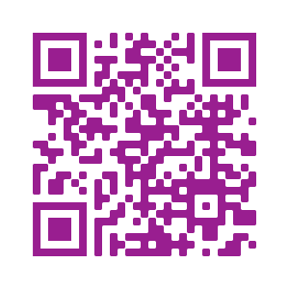
Please fill out the survey! & Win Swags!!
https://www.powerplatformbootcamp.com/survey

Slide 17
Thank You For Attending

